Slide 1
ADVANCED SMART METERING FOR ELECTRICITY THEFT DETECTION AND POWER MONITORING
Manipal Institute of Technology, Manipal
CISCON 2023
Tilak Rajendra Dave,
Akash Abhay Deshmukh,
Patil Jiyan Afasarpasha,
Ayush Ramchandra Tathe
Student, Vishwakarma Institute of Technology

Slide 2
Introduction
Literary Review
Agenda
Framework
Methodology
Results
Analysis and Conclusion

Slide 3
Introduction
High Electricity Theft Rates in India
In 2019, India faced a 14% electricity theft rate, causing significant financial losses for power companies.
Advanced Solutions: IoT and Machine Learning
We propose an IoT-based system integrating statistical algorithms and machine learning to combat electricity theft efficiently.
Benefits: Reduced Losses and Improved Billing
Our approach aims to reduce financial losses, enhance billing accuracy, and improve the quality of power supply in India.

Slide 4
Literary Review
Paper Title | Key Findings
Machine Learning for Theft Detection | High accuracy achieved using machine learning on smart meter data for electricity theft detection.
IoT-Based System for Detection | An IoT-based system proposed for electricity theft detection, improving efficiency in detecting theft.
IoT for Smart Grids | IoT-based system enhances smart grid security for electricity theft detection in smart grids.
Blockchain for Secure Electricity Billing | Blockchain technology can enhance the security and transparency of electricity billing, reducing opportunities for theft and fraud.

Slide 5
Literary Review
Reference | Key Findings
"Smart Meter Analytics for Theft Detection" | Smart meters combined with advanced analytics offer a highly accurate method for detecting electricity theft.
"IoT-Enabled Electricity Theft Detection" | The use of IoT devices and real-time data analysis has shown promising results in the early detection of theft.
"Machine Learning Approaches for Theft Detection" | Machine learning algorithms, particularly neural networks, have proven effective in identifying electricity theft patterns.
"Data Visualization for Theft Detection" | Data visualization techniques, such as network analysis, can uncover suspicious patterns in electricity consumption indicative of theft.

Slide 6
Framework
Component | Description
Distributor Side Circuit | ESP32 microcontroller, ZMPT101B Voltage Sensor, ACS712 Current Sensor, Single Channel Relay Module
Consumer Side Circuit | ESP32 microcontroller, ZMPT101B Voltage Sensor, ACS712 Current Sensor
API Server | Python Flask, JSON, Repl.it
Mobile Application | React JS, Progressive Web Application (PWA)

Slide 7
Methodology
IoT modules, installed on both consumer and distributor sides, gather and process sensor data meticulously, ensuring accurate readings of electricity consumption.
Data is seamlessly relayed to the distributor via our API server. In case of theft detection, the distributor side has the capability to deactivate the circuit instantly, while notifying the user through the mobile application.
To enhance theft detection and prevention, the application conducts regular 15-second intervals checks to verify if the theft has been resolved, subsequently deciding whether to re-establish or cut off the circuit, thus ensuring a robust monitoring and security system.
Architechture Diagram of our system is porposed in the next slide.

Slide 8
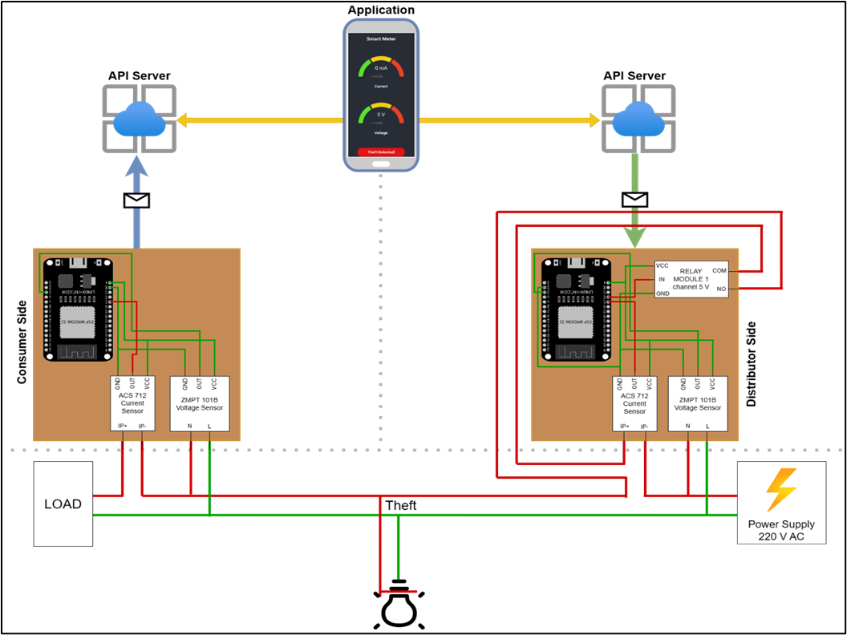

Slide 9
Results
The IoT-based smart electricity monitoring and theft detection system has been effectively implemented, offering real-time monitoring and accurate theft detection.
The system's use of highly accurate voltage and current sensors, efficient data transfer, and storage via WiFi-equipped IoT modules, and secure SSL/TLS encryption contribute to its accuracy and efficiency.
The consumer-side mobile application provides an intuitive interface for users to access and interpret their electricity consumption data, making it accessible to a wide range of users
Comparison of Voltage and Current against time in before and after theft detection is given on the next slide.

Slide 10
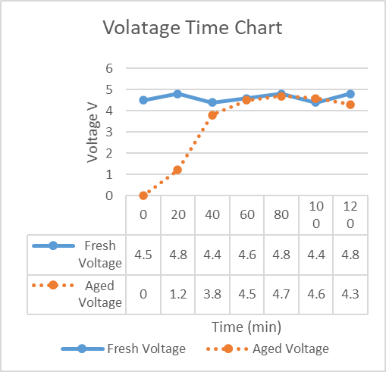
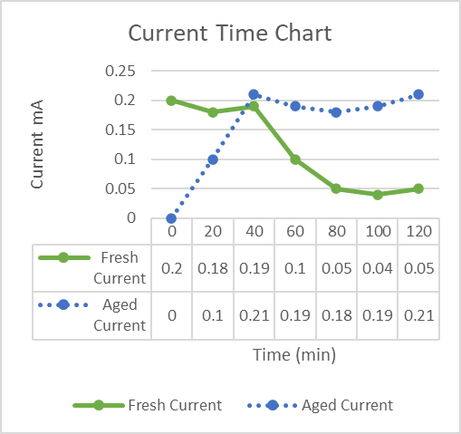

Slide 11
Analysis and Conclusion
The proposed system offers an efficient and user-friendly solution for optimizing Windows operating systems, simplifying tasks for users of varying technical expertise.
It stands out for its simplicity and effectiveness compared to alternative software solutions, featuring an intuitive graphical user interface and streamlining the optimization process.
While it has limitations, such as the need for administrative privileges and occasional compatibility issues, it remains a valuable tool for enhancing system performance.

Slide 12
Refrences
Ferreira, J. A., Tavares, G. M., Ferreira, P. H., Pinto, J. G., Pinto, M. H. (2020). A machine learning approach to electricity theft detection using smart meter data. Energy, 203, 117858
Kumar, A., Saini, R., Singh, V. P. (2019). An IoT-Based Approach to Detect Electricity Theft. Wireless Personal Communications, 107(4), 2567-2579.
Al-Abdullah, A. J., Ahmad, N., Hussain, M., Alhumoud, A., Alrajhi, M. (2021). An IoT-Based System for Electricity Theft Detection in Smart Grids. IEEE Access, 9, 30362-30373.
Zhang, T., Lin, X., Huang, J., Li, L., Lv, J. (2019). A blockchainbased approach for detecting electricity theft in smart grids. Journal of Network and Computer Applications, 146, 79-86.
M Halsey, A Bettany, M Halsey, A Bettany - Windows Registry - Springer: Registry Tools and Utilities (2015)
Choquet, R., Lebreton, J.-D., Gimenez, O., Reboulet, A.-M. and Pradel, R. 2009. U-CARE: Utilities for performing goodness of fit tests and manipulating cApture–REcapture data. – Ecography 32: 1071–1074(Version 2.3).
Hipson, Peter D., Maureen Forys, Design Site, and Sergie Loobkoff: Mastering Windows XP Registry. Sybex, 2002.

Slide 13
Refrences
Stallings, William. "The Windows Operating System." Operating Systems: Internals and Design Principles (2005).
Chaganti, Ravikanth. (2014). Beginning Windows PowerShell. 10.1007/978-1-4842-0016-2_1.
Olusanya, Olayinka & Ogunbanwo, Afolakemi & Lateef, Usman & G.O., Odulaja. (2016). MICROSOFT WINDOWS OPERATING SYSTEM.
Kayani, M. & Abrar, & Waleed, & Ijaz, & Nabeel, & Maham, Rabbani. (2010). Evolutionary Aspects Of Windows Operating System To Enhance Existing Technology. International Journal on Computer Science and Engineering.
Moran, Joseph, and Joseph Moran. "Managing and Reclaiming Disk Space." File Management Made Simple, Windows Edition (2015): 53-62.
Dunn S. Take System Cleanup Into Your Own Hands. PC World. 1999;17(1):232-4.
Nihad Ahmad Hassan, Rami Hijazi:Chapter 6 - Data Hiding Forensics,Data Hiding Techniques in Windows OS,Syngress,(2017)
Jorge Orchilles,Chapter 5 - Managing the Windows 7 Desktop Environment,Microsoft Windows 7 Administrator's Reference,Syngress,(2010)

Slide 14
Thank you!

